Slide 1
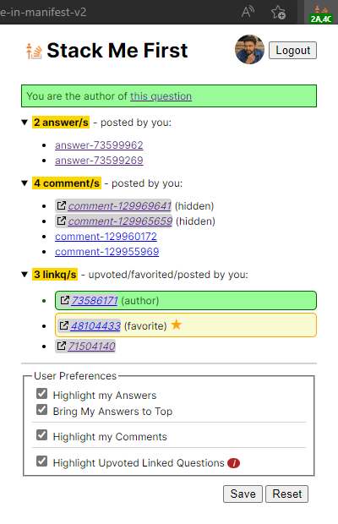
Popup Instructions
Reference Link: https://stackoverflow.com/q/73591695/6908282
1
8
7
5
2
3
6
9
c
b
a
4

Slide 2
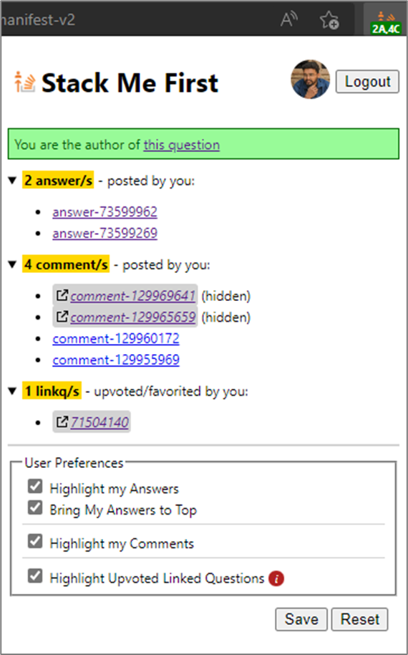
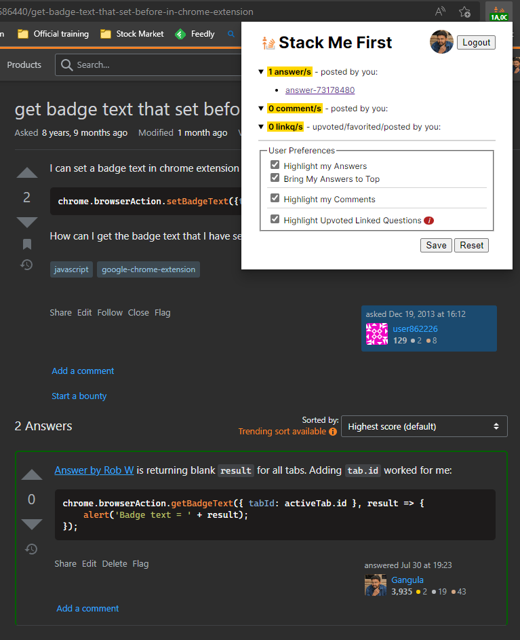
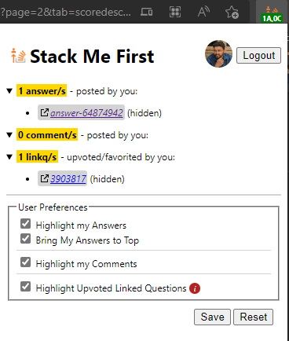
Answers by you
Reference Link: git - How do I update or sync a forked repository on GitHub? - Stack Overflow
https://stackoverflow.com/q/20686440/6908282
https://stackoverflow.com/q/73591695/6908282

Slide 3
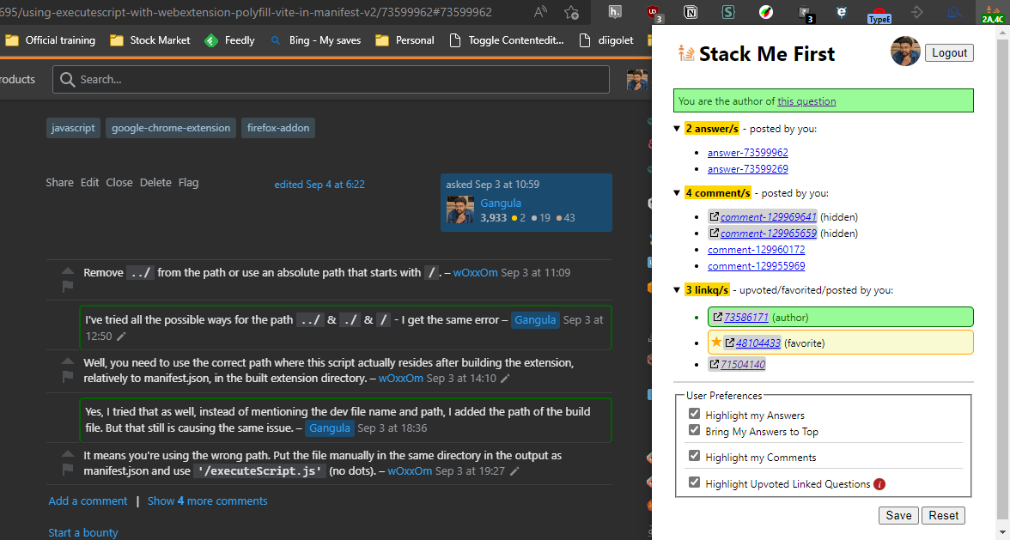
Comments by you
Reference Link: https://stackoverflow.com/q/73591695/6908282

Slide 4
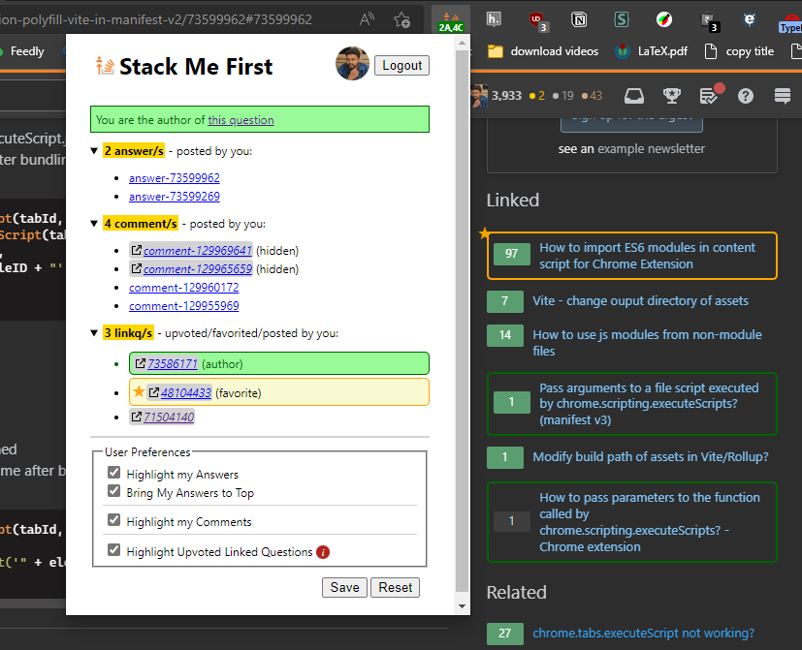
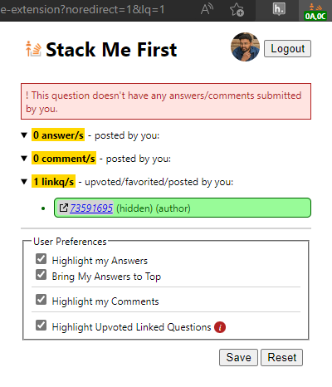
Upvoted/Favorited Linked Questions
Reference Link: https://stackoverflow.com/q/59546370/6908282

Slide 5

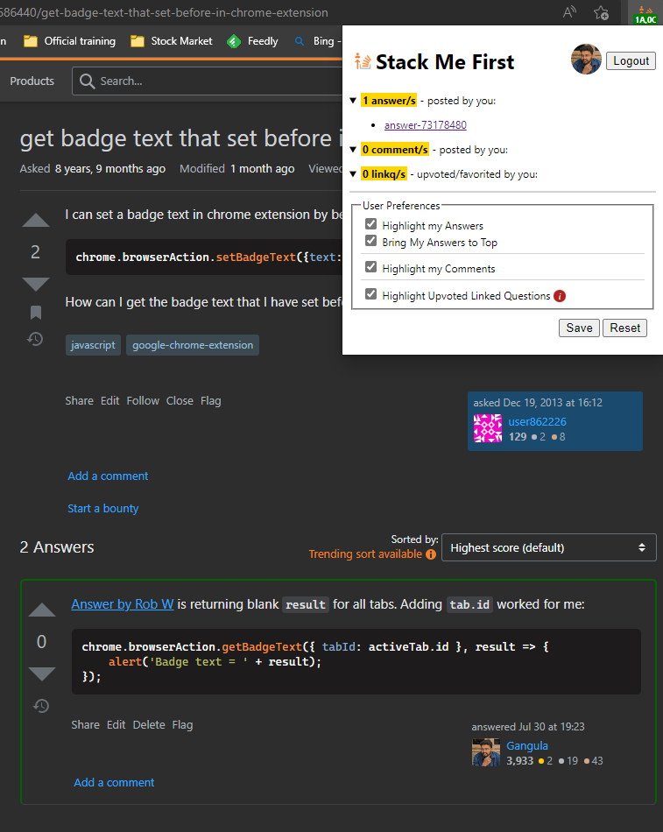
Original Screenshots

